Slide 1

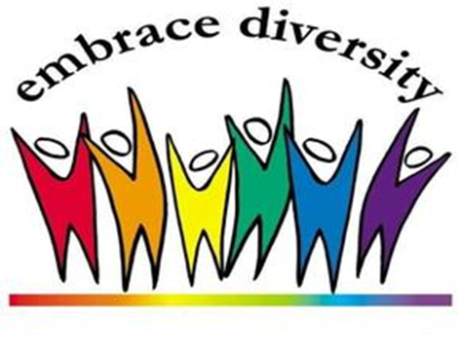
SOSC LLC
ANNUAL STAFF TRAINING

Slide 2
https://www.youtube.com/watch?v=qpPYdMs97eE
Notes:
When we focus on one thing, we miss everything around it!
Did you notice:
The motor scooter changed to two bikes
Pink house now has a striped awning
The pink house changed from pink and red to beige and red
The green house changed to a blue house
Woman walking down the street
The name on the green building changed
The black smaller car changed to a van
The brick and green house has multi colored streaming on it
The brick and green house went from no address on there, to an address on there
The brick and green house changed to a light green and dark green house with a balcony
There’s a ladder leaning up against the light green and dark green house
The lady holding a pig

Slide 3

What Is Diversity?
  Diversity is differences in racial and ethnic, socioeconomic, geographic, and academic/professional backgrounds. People with different opinions, backgrounds (degrees and social experience), religious beliefs, political beliefs, sexual orientations, heritage, and life experience.
The Mix
Notes:
"Diversity" means more than just acknowledging and/or tolerating difference. Diversity is a set of conscious practices that involve:
Understanding and appreciating interdependence of humanity, cultures, and the natural environment.
Practicing mutual respect for qualities and experiences that are different from our own. Understanding that diversity includes not only ways of being but also ways of knowing; Recognizing that personal, cultural and institutionalized discrimination creates and sustains privileges for some while creating and sustaining disadvantages for others; Building alliances across differences so that we can work together to eradicate all forms of discrimination.
Diversity includes, therefore, knowing how to relate to those qualities and conditions that are different from our own and outside the groups to which we belong, yet are present in other individuals and groups. These include but are not limited to age, ethnicity, class, gender, physical abilities/qualities, race, sexual orientation, as well as religious status, gender expression, educational background, geographical location, income, marital status, parental status, and work experiences. Finally, we acknowledge that categories of difference are not always fixed but also can be fluid, we respect individual rights to self-identification, and we recognize that no one culture is intrinsically superior to another.

Slide 4
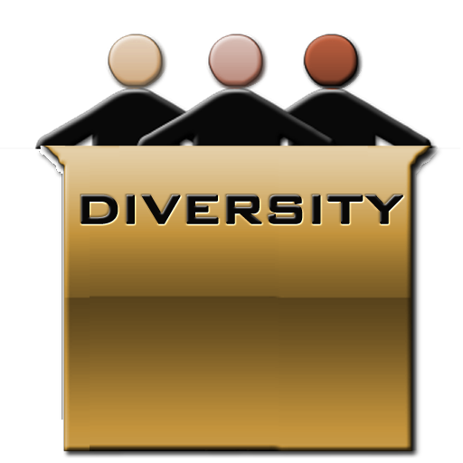

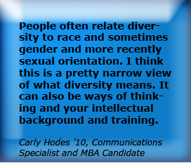
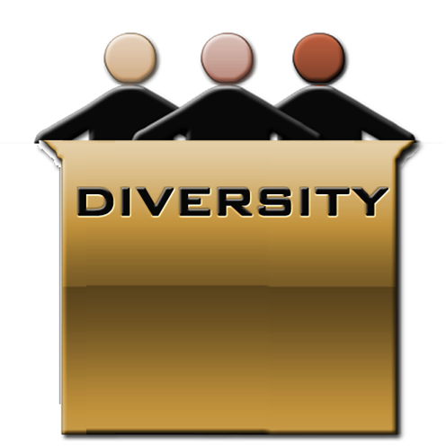

Slide 5


What Is Inclusion?
Inclusion involves bringing together and harnessing diverse forces and resources in a way that is beneficial. Inclusion puts the concept and practice of diversity into action by creating an environment of involvement, respect, and connection—where the richness of ideas, backgrounds, and perspectives are harnessed to create business value and overall success.
Inclusion: “Making the Mix Work”
Source: http://www.diversityjournal.com/1471-moving-from-diversity-to-inclusion/

Slide 6
Diversity in College Athletics
  http://s3.amazonaws.com/ncaa/web_video/diversity_inclusion/diversityInAthletics.html

Slide 7
What is the difference between diversity
and inclusion?
  Diversity is simply a representation of many different types of people
  (gender, race, ability, religion, etc.)
  Diversity often focuses on the differences, and is referred to as "the mix.“
  Inclusion is the deliberate act of welcoming diversity and creating an environment
  where all different kinds of people can thrive and succeed.
  Inclusion is the act of "making the mix work."
  Diversity is what you have. Inclusion is what you do.
    Simply having a diverse group, team, workforce, classroom, etc., is not enough.
    *Everyone should feel safe and encouraged to fully participate and share and be on equal footing
    as everyone else.
Source: Tiffany Jana
CEO at TMI Consulting Inc.

Slide 8
Why Does Diversity Matter at College Anyway?
1. Diversity expands worldliness. College might be the first time you have had the opportunity to have real interaction with people from diverse groups.
2. Diversity enhances social development. Interacting with people from a variety of groups widens your social circle by expanding the pool of people with whom you can associate and develop relationships.
3. Diversity prepares students for future career success. Successful performance in today's diverse workforce requires sensitivity to human differences and the ability to relate to people from different cultural backgrounds.
4. Diversity prepares students for work in a global society. No matter what profession you enter, you'll find yourself working with employers, employees, coworkers, customers and clients from diverse backgrounds—worldwide.
Source: Aaron Thompson, professor of sociology at Eastern Kentucky University and coauthor (with Joe Cuseo) Diversity and the College Experience
Notes:
8 ways meeting and working with different people in college can help you in the future.
1. Diversity expands worldliness. College might be the first time you have had the opportunity to have real interaction with people from diverse groups. Whether we like it or not, many times we find ourselves segregated from other groups in schools, churches, and our own neighborhoods. A college campus is like opening the door to the entire world without traveling anywhere else.
2. Diversity enhances social development. Interacting with people from a variety of groups widens your social circle by expanding the pool of people with whom you can associate and develop relationships. Consider how boring your conversations would be if you only had friends who had everything in common with you.
3. Diversity prepares students for future career success. Successful performance in today's diverse workforce requires sensitivity to human differences and the ability to relate to people from different cultural backgrounds. America's workforce is more diverse than at any time in the nation's history, and the percentage of America's working-age population comprised of members of minority groups is expected to increase from 34 percent to 55 percent by 2050.
4. Diversity prepares students for work in a global society. No matter what profession you enter, you'll find yourself working with employers, employees, coworkers, customers and clients from diverse backgrounds—worldwide. By experiencing diversity in college, you are laying the groundwork to be comfortable working and interacting with a variety of individuals of all nationalities.

Slide 9
Why Does Diversity Matter at College Anyway?
5. Interactions with people different from ourselves increase our knowledge base. Research consistently shows that we learn more from people who are different from us than we do from people who are similar to us.
6. Diversity promotes creative thinking. Diversity expands your capacity for viewing issues or problems from multiple perspectives, angles, and vantage points.
7. Diversity enhances self-awareness. Learning from people whose backgrounds and experiences differ from your own sharpens your self-knowledge and self-insight by allowing you to compare and contrast your life experiences with others whose life experiences differ sharply from your own.
8. Diversity enriches the multiple perspectives developed by a liberal arts education.
Notes:
5. Interactions with people different from ourselves increase our knowledge base. Research consistently shows that we learn more from people who are different from us than we do from people who are similar to us. Just as you "think harder" when you encounter new material in a college course, you will do the same when you interact with a diverse group of people.
6. Diversity promotes creative thinking. Diversity expands your capacity for viewing issues or problems from multiple perspectives, angles, and vantage points. These diverse vantage points work to your advantage when you encounter new problems in different contexts and situations. Rather than viewing the world through a single-focus lens, you are able to expand your views and consider multiple options when making decisions and weighing issues of, for example, morality and ethics.
7. Diversity enhances self-awareness. Learning from people whose backgrounds and experiences differ from your own sharpens your self-knowledge and self-insight by allowing you to compare and contrast your life experiences with others whose life experiences differ sharply from your own. By being more self-aware, you are more capable of making informed decisions about your academic and professional future.
8. Diversity enriches the multiple perspectives developed by a liberal arts education. Diversity magnifies the power of a general education by helping to liberate you from the tunnel vision of an ethnocentric and egocentric viewpoint. By moving beyond yourself, you gain a panoramic perspective of the world around you and a more complete view of your place in it.

Slide 10

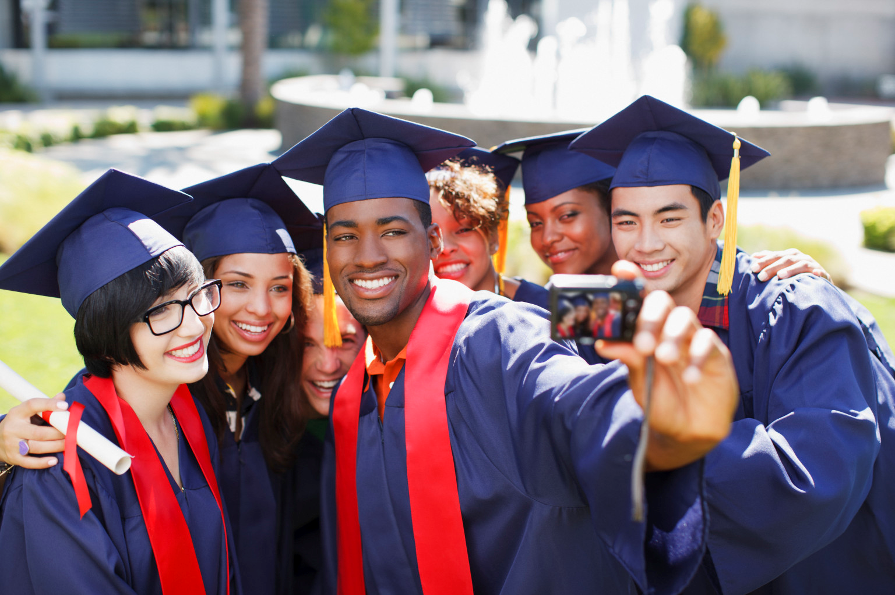
College Diversity Snapshot
Top five diverse colleges-US (National)
Universities and Colleges, and diversity
Diversity in college athletics

Slide 11
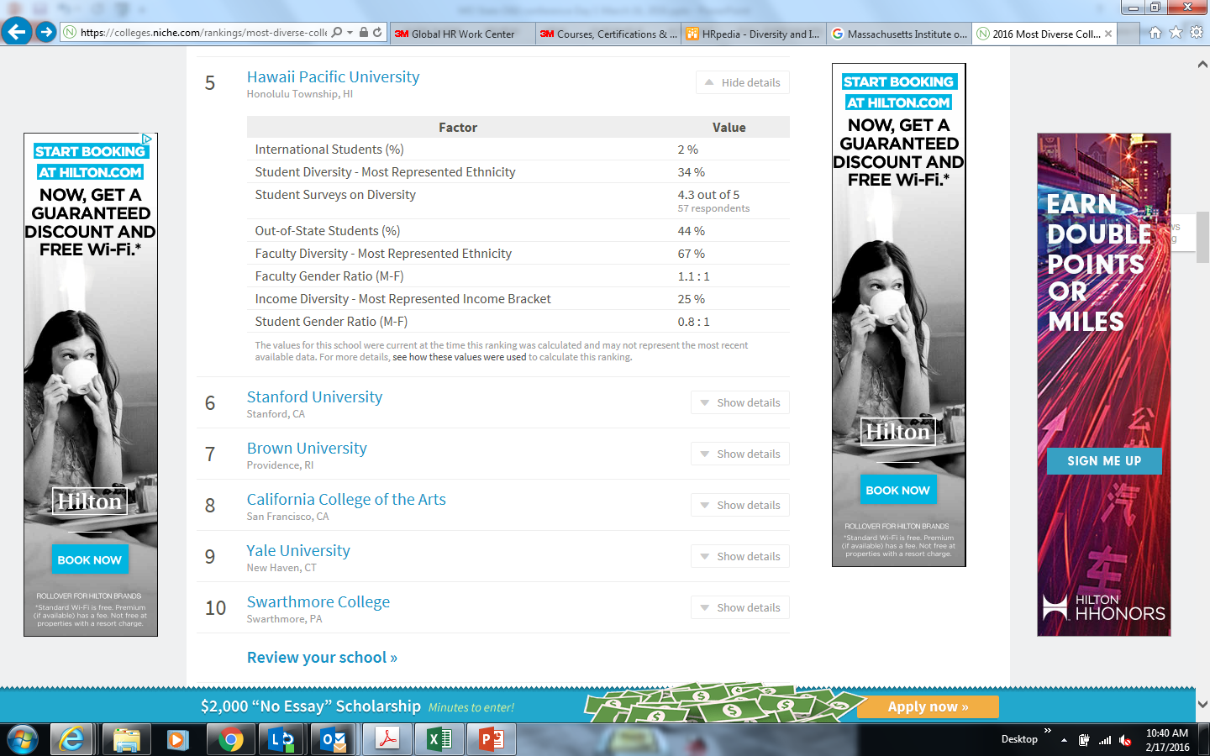

2016 Top Five Diverse Colleges –US (Nationally)

Slide 12
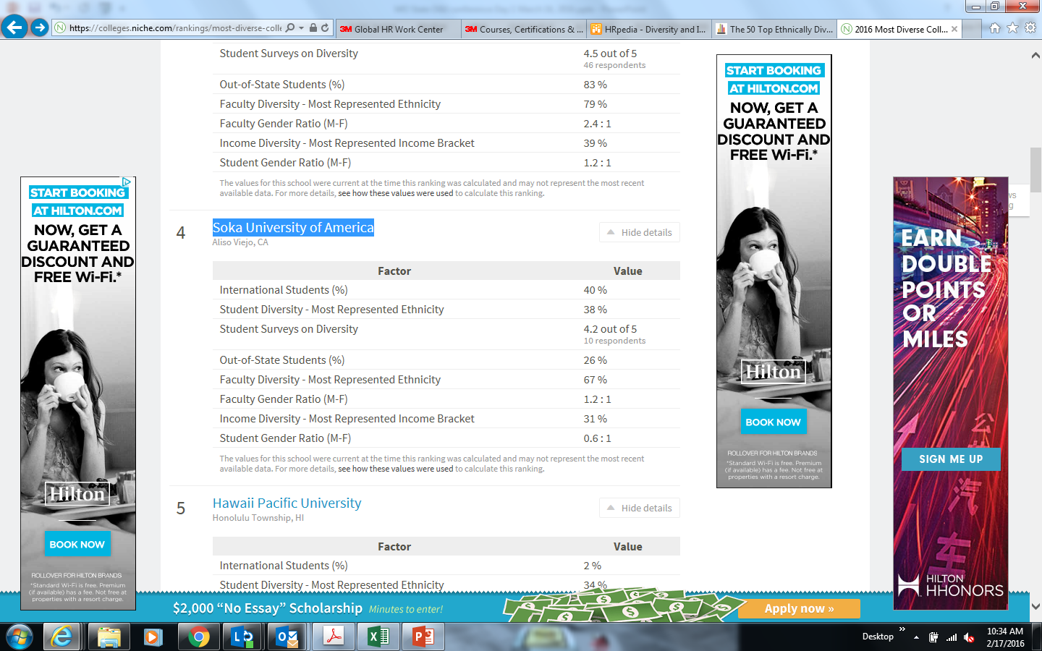

2016 Top Five Diverse Colleges –US (Nationally)
Source: https://colleges.niche.com/rankings/most-diverse-colleges/

Slide 13
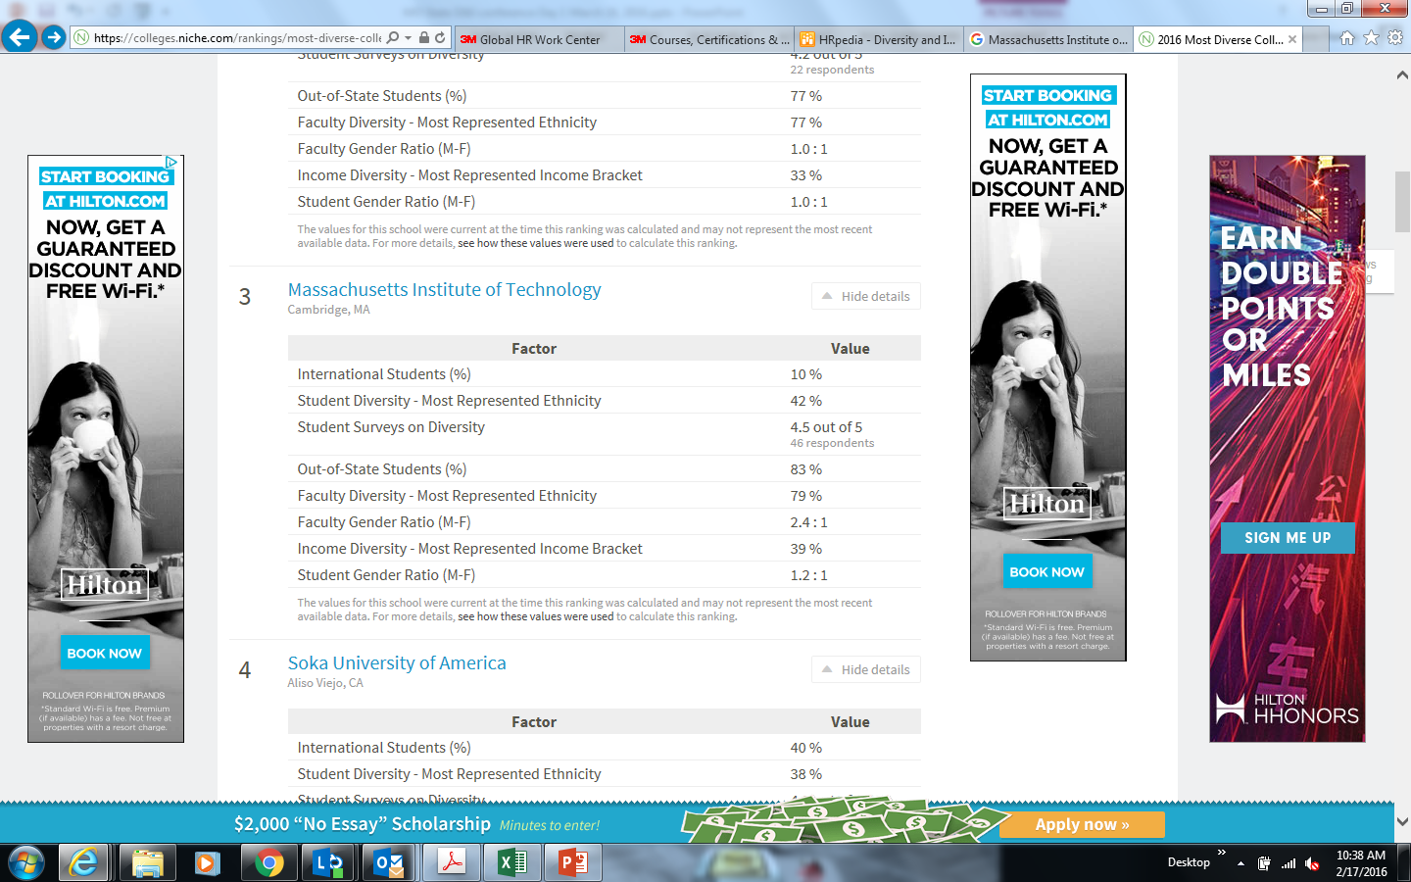

2016 Top Five Diverse Colleges –US Nationally

Slide 14
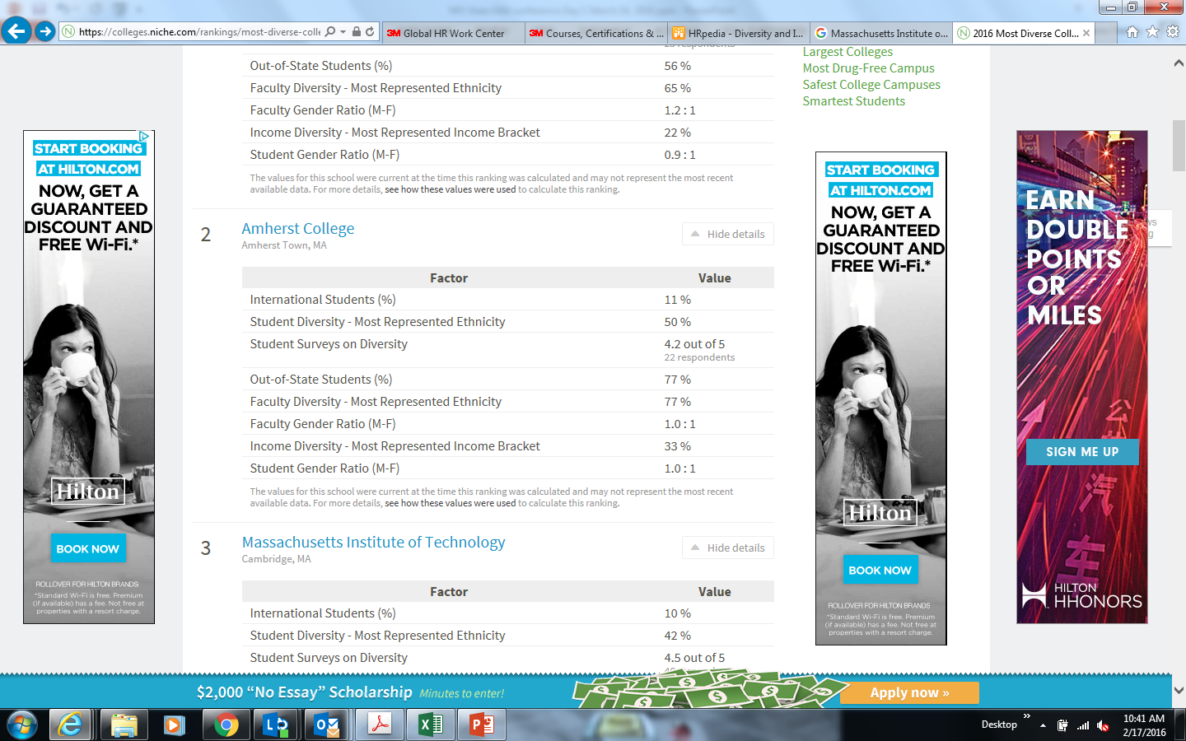

2016 Top Five Diverse Colleges –US Nationally

Slide 15
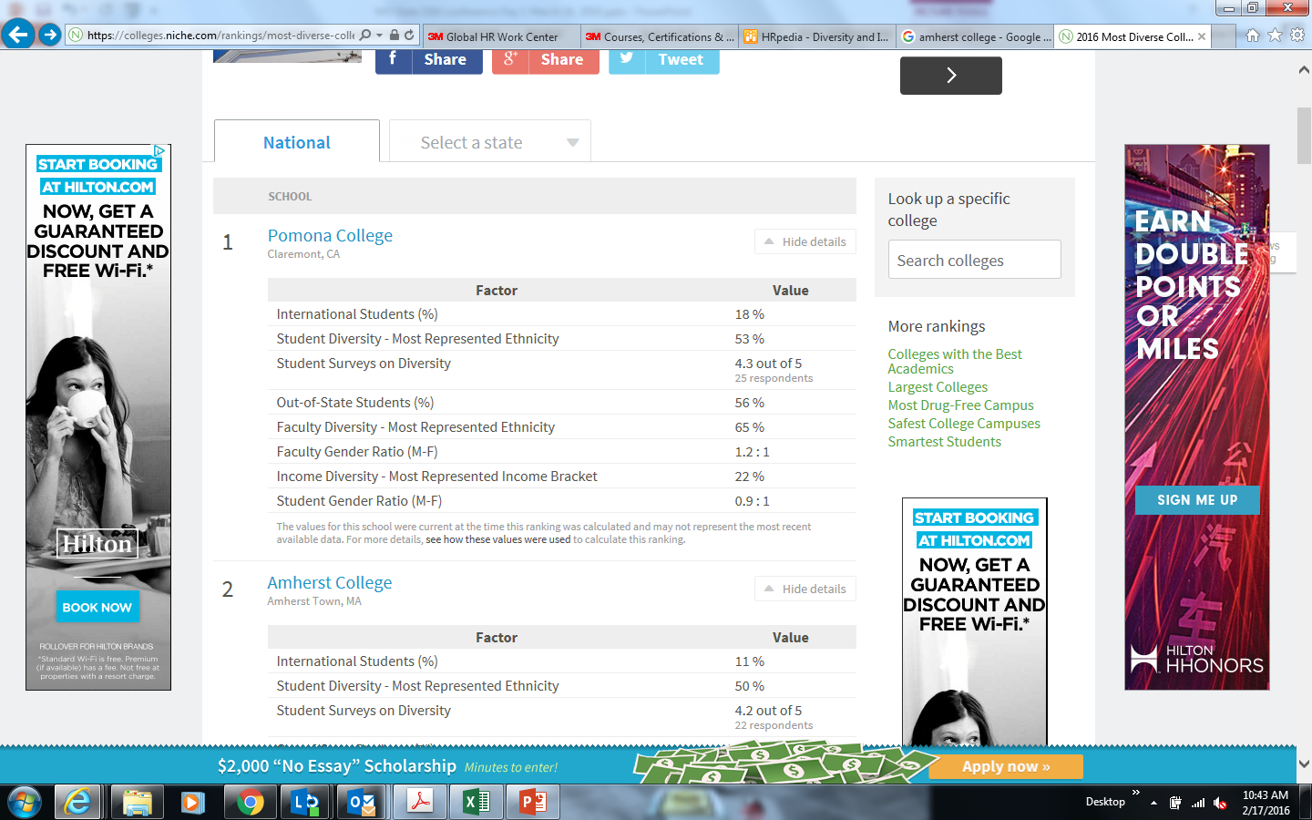


2016 Top Five Diverse Colleges –US Nationally

Slide 16
Diversity and Inclusion in College
http://www.ncaa.org/about/resources/inclusion

Slide 17
NCAA Inclusion Forum - Video
  NCAA Inclusion Forum

Slide 18

How Can You Embrace Your Diversity as a
College Student?
5 Minute Group Discussion

Slide 19
How To Embrace Your Diversity?
1. Everyone’s Narrative - Consider your own life, and everything that has shaped your beliefs. Realize that each of the 7 billion people on this planet has their own narrative. Not one is the same.
2. Where are you coming from? - When you find yourself thinking poorly of someone, stop and consider what influences have created your negative views of that individual.
3. Befriend all people – If you know that you tend to avoid befriending certain types of people, go out of your way to find friends of all kinds.
4. Empathy – When you encounter anyone, try to imagine, understand, and sympathize with that person’s story, with everything that has made them who they are.
5. Actively accept – meditate upon embracing other people, with all of the diversity that comes with them. Don’t allow yourself to define a person based upon one stereotype about one aspect of their complex identity.
6. Show compassion - Perform random acts of kindness for all types of people. It can be as simple as a friendly smile or holding open a door.
Source: http://www.refinethemind.com/embracing-diversity/
Notes:
The Beauty of Diversity
The human race is extraordinarily diverse in so many ways. Gender, ethnicity, race, class, religion, nationality, sexuality, philosophy, lifestyle. The areas in which we differ are endless.
Yet, at a basic level, we are all of the same human species. We experience highs and lows in life and strive to be happy and fulfilled.
Our common pains and joys are what bring us together, but our diversity makes us unique. It is what deems you or I our own special person, one who has never existed and will never exist again.

Slide 20
VIDEO……….
Respect & inclusion at Deloitte
https://www.youtube.com/watch?v=7G0OUHnCudw

Slide 21

Questions

Slide 22


